Slide 1



NGO Donation Management and Distribution System
by mishak manuel

Slide 2

Challenges in Donation Management
1
Inefficient Tracking
2
Poor Community Needs Management
Lack of a structured system to track donations, their types, quantities, and allocation to communities in need.
Difficulty in maintaining accurate and up-to-date records of community needs and the status of donated items.
3
Lack of Transparency
4
Manual and Error-Prone Processes
Inability to provide transparent reports to donors and stakeholders about the utilization of donations.
Manual handling of donation data leading to errors and inefficiencies in addressing poverty.

Slide 3
Objectives of the Database System
Efficient Donation Management
Transparent Distribution
Enhanced Community Management
Track and manage all donations received by the NGO, including their type, quantities, and status.
Ensure that donations are allocated appropriately to communities based on their needs and track the status of these donations in real-time.
Enable community managers to update the status of received items and provide feedback on the adequacy of resources.

Slide 4
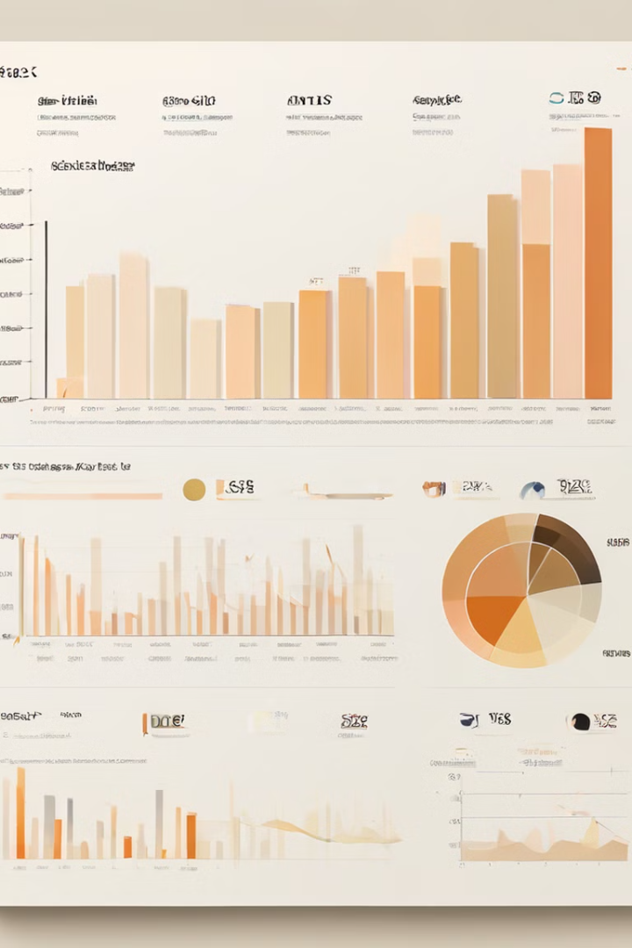
Key Features of the Database System
User Management
Manage user access, roles, and responsibilities, including Admin, Donor, and Community Manager.
Donation Tracking
Track monetary and in-kind donations, manage their status, and handle remaining quantities.
Community Management
Track communities receiving donations, assign community managers, and update the status of donations in real-time.
Reporting and Transparency
Generate reports on donation status, community needs, and distribution efficiency to provide transparency to stakeholders and donors.

Slide 5




Data Security and Integrity
Data Encryption
Access Control
Audit Logs
Protect sensitive donor and community data through advanced encryption techniques.
Implement role-based access controls to ensure only authorized personnel can access specific data.
Maintain detailed audit logs to track changes made to the database and ensure accountability.

Slide 6

Expected Impact
1
Reduced Poverty
Efficiently and effectively distribute resources to the communities most in need, contributing to poverty alleviation.
2
Increased Efficiency
Automate donation management processes, reduce errors, and ensure timely delivery of aid to those who need it.
3
Enhanced Transparency
Provide detailed reports to stakeholders, building trust and encouraging more donations to support the cause.

Slide 7

Aligning with the Sustainable Development Goals
SDG 1: No Poverty
This database system directly supports the achievement of SDG 1 by enhancing the capacity of NGOs to efficiently manage and distribute donations to communities in need.
Other Relevant SDGs
The system's focus on transparency, accountability, and data security also contributes to the realization of SDG 16 (Peace, Justice and Strong Institutions) and SDG 17 (Partnerships for the Goals).
Holistic Approach
By addressing the challenges in donation management, this project takes a comprehensive approach to supporting the Sustainable Development Goals and creating a lasting impact on the lives of those in poverty.

Slide 8




Transforming Donation Management
Streamlined Processes
The database system automates and streamlines the management of donations, reducing errors and improving efficiency.
Targeted Distribution
Effective allocation of resources based on community needs ensures that donations reach those who need them most.
Increased Transparency
Detailed reporting and accountability measures build trust with donors and stakeholders, leading to more support for the cause.

Slide 9
Empowering NGOs for Greater Impact
Donor Confidence
Community Engagement
Data-Driven Decisions
The transparent and efficient management of donations will strengthen donor confidence, encouraging more individuals and organizations to support the NGO's efforts.
The robust reporting capabilities of the database system will enable NGOs to make data-informed decisions, optimizing their donation management and distribution strategies.
By involving community managers in the process, the system fosters stronger relationships and ensures that the donations address the specific needs of the communities served.

Slide 10

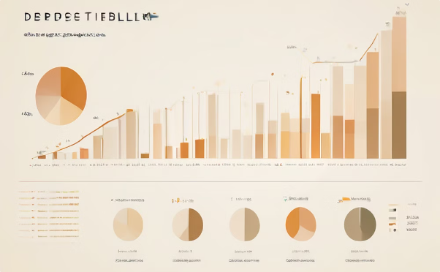
Conclusion: Empowering NGOs to Fight Poverty
Targeted Aid Delivery
Transparent and Accountable Operations
The database system ensures that donated resources are efficiently distributed to the communities that need them the most, making a tangible difference in the lives of those experiencing poverty.
By providing detailed reports and enhancing accountability, the system builds trust with donors and stakeholders, leading to increased support and a greater impact on poverty alleviation.
In conclusion, this database system is a transformative solution that empowers NGOs to streamline their donation management and distribution processes, ultimately contributing to the achievement of Sustainable Development Goal 1: No Poverty. By addressing the key challenges faced by NGOs, this system will help drive more efficient and effective resource allocation, fostering lasting change in the communities they serve.

